Slide 1
The VALEW Model & Guidelines
Valew Final Conference
Tallinn
3 June 2010

Slide 2
Why validating learning at work
More learning
Every day
In every context
Recognised and rewarded
Emancipated from education provision

Slide 3
VALEW Readiness Index
 | Potential users | employers | Stakeholders | Policy makers | Synthesis score
Needs perceived
Awareness of possible solutions
Willingness to committ
Willingness to pay
Existence of professional capacity in the system
Actual use
Legislative/regulation conditions
Qualification framework in place

Slide 4
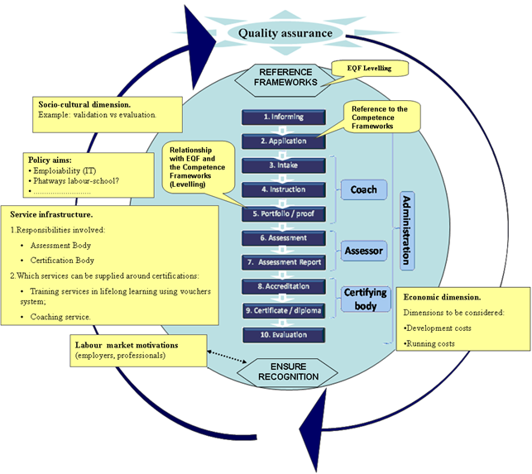
The model core

Slide 5
VALEW as a Metamodel
ESTONIA
MILAN
GERMANY
Implementation strategy
CORE METHOD

Slide 6
VALEW Guidelines
Identification of Standards
Collection of Evidence
Recognition, Assessment, and Certification
Reference to NFQ/EFQ
Ensure Recognition

Slide 7
1. Identification of standards
Basic concepts and definitions
Linking Labour Market to the Lifelong Learning System
Development of Competence Standards and Frameworks

Slide 8
Competence circle
Expected competences
L
A
B
O
U
R
M
A
R
K
E
T
Job
task
Occu-
pational
stan-
dard
Edu-
cation
stan-
dard
Curri-
culum
L
E
A
R
N
I
N
G
Com-
peten-
ce
Dip-
loma,
certifi-
cate
VOCATIONAL
QUALIFICATIONS SYSTEM
Qualification
awarding
Validation
Assessment
Actual competences

Slide 9
2. Collection of evidences
Evidence Identification and Collection Procedures
Portability of Evidence
Evidence Categories
Assigning Levels to Evidences
How to Build and Evaluate Evidence

Slide 10
The three dimensions of proficiency-learning levels

Slide 11
3. Recognition, Assessment, and Certification
The Overall Rationale: The total VPL Process in 5 Phases and 10 Steps
VPL in 5 Phases
Types of Award

Slide 12
5 phases and 10 steps

Slide 13
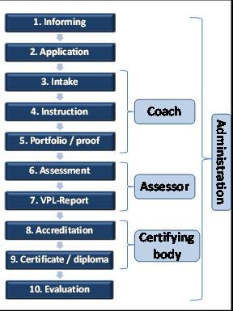
The accreditation procedure

Slide 14
4. Reference to NQF/EQF
Three cases
Learning outcomes correspond to NQF
Learning outcomes agreed at sectoral level
Learning outcomes not corresponding to defined qualification framework

Slide 15
Different kinds of qualifications

Slide 16
5. Ensure recognition (1/2)
Which Players can Recognise?
  public authorities
  Sectoral and professional bodies with recognised certification functions
  education and training providers
  On the informal dimension:
  employers and final users

Slide 17
5. Ensure recognition (2/2)
Main Criticalities/ Key Factors of Success
Early involvement of relevant players
Combined effort by all players
Service infrastructure in place
Communication strategy

Slide 18
Valew added
Based on multiple concrete experiences
Validated at european level
Allowing flexibility to adapt to different national and organisational contexts
Allowing benchmarking and benchlearning
Evolutionary, open to future development

Slide 19
Thank you! cdondi@scienter.org

